Slide 1


Geospatial Analysis of Credit Card Fraudulent
Transactions
Dr. Lindi Liao Duoduo
AIT 614-005
23rd April 2024
TEAM 7
Chanyoung Park, Nithiya Varsha Markandan Rajedren, Samhita Sarikonda, Vishal Orsu, Ravi Datta Rachuri

Slide 2

INTRODUCTION
Project Overview: Enhancing Credit Card Fraud Detection with Geospatial Analysis
Challenge: Current fraud detection systems struggle with evolving fraud tactics and their complexity.
Innovative Approach: Integrating geospatial analysis with traditional methods for improved fraud detection.
Key Differentiators:
Geographic Insights: Identifies high-risk areas through spatial transaction analysis.
Enhanced Detection: Combines transactional and geographic data to improve accuracy.
Targeted Prevention: Delivers region-specific anti-fraud strategies for financial institutions.

Slide 3

OBJECTIVES
Primary Goal: Leverage geospatial analysis for more effective credit card fraud detection and prediction.
Objectives:
Identify high-risk geographic regions for credit card fraud.
Integrate geospatial data into existing fraud detection frameworks to enhance accuracy.
Develop a comprehensive model using transactional and geographic data to pinpoint potential fraud.
Outcome: Provide financial institutions with advanced tools for improved fraud prevention and customer security.

Slide 4
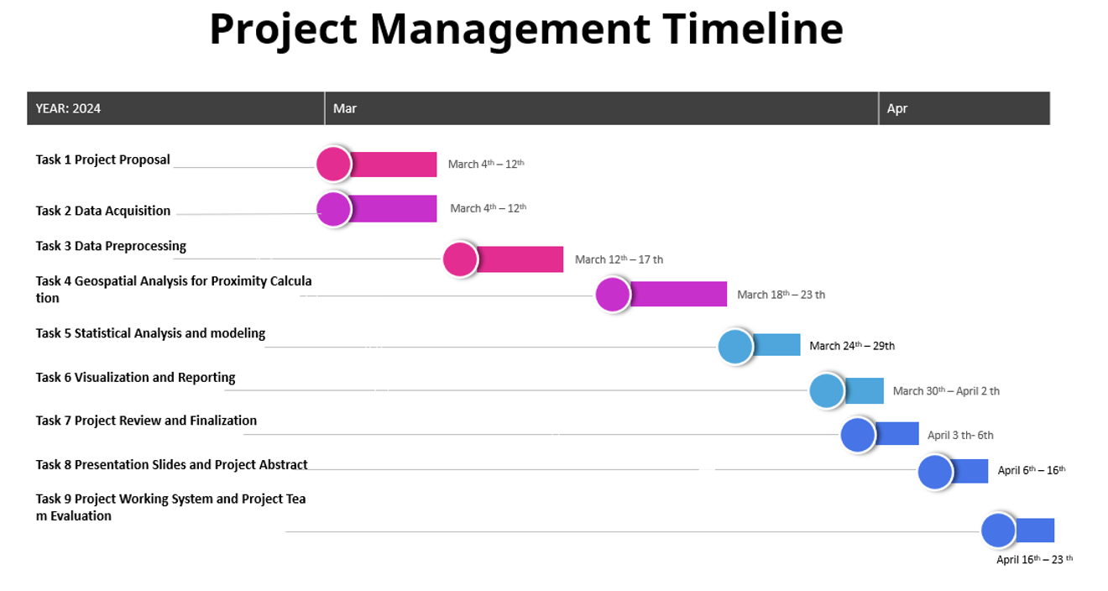
SUMMARIZED PROJECT TIMELINE
March 4 – 12: Project Proposal & Data Acquisition
March 12 – 17: Data Preprocessing
March 18 – 23: Geospatial Analysis for Proximity Calculation
March 24 – 29: Statistical Analysis and Modeling
March 30 – April 2: Visualization and Reporting
April 3 – April 6: Project Review and Finalization
April 6 – April 16: Presentation Slides and Project Abstract
April 16 – April 23: Project Working System

Slide 5

SELECTED DATASET
Source: Available in Kaggle
Transactional Details: Time, anonymized card numbers, merchant info, categories, and amounts.
Geographic Coordinates: Latitude and longitude for transaction and merchant locations.
Demographic Information: Age, occupation, and city of residence of cardholders.
Fraud Flag: Transactions labeled as 'fraudulent' or 'non-fraudulent'.
Analysis Applications: Enables consumer behavior studies and geospatial fraud detection.
Project Relevance: Provides a rich dataset for enhancing fraud detection models using advanced analytics.

Slide 6

THE SYSTEM
Architecture/Framework:
Core Platform: Databricks - Unified analytics platform integrating data processing, machine learning, and collaborative workflows.
Data Processing & Analytics:
Tools: Spark with Python (PySpark) for distributed computing and efficient data transformations.
Machine Learning: Spark MLlib used for regression, Random Forest, and Gradient Boost tasks.
Software/Hardware Development:
Platform: Databricks as scalable cloud-based infrastructure for data analysis.
Services: Cloud-based tools within Databricks for advanced data management and processing.

Slide 7
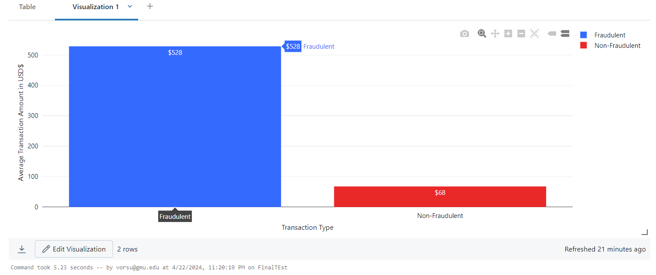
EXPERIMENTAL RESULTS AND ANALYSIS
AVERAGE TRANSACTION AMOUNT VS TRANSACTION TYPE

Slide 8
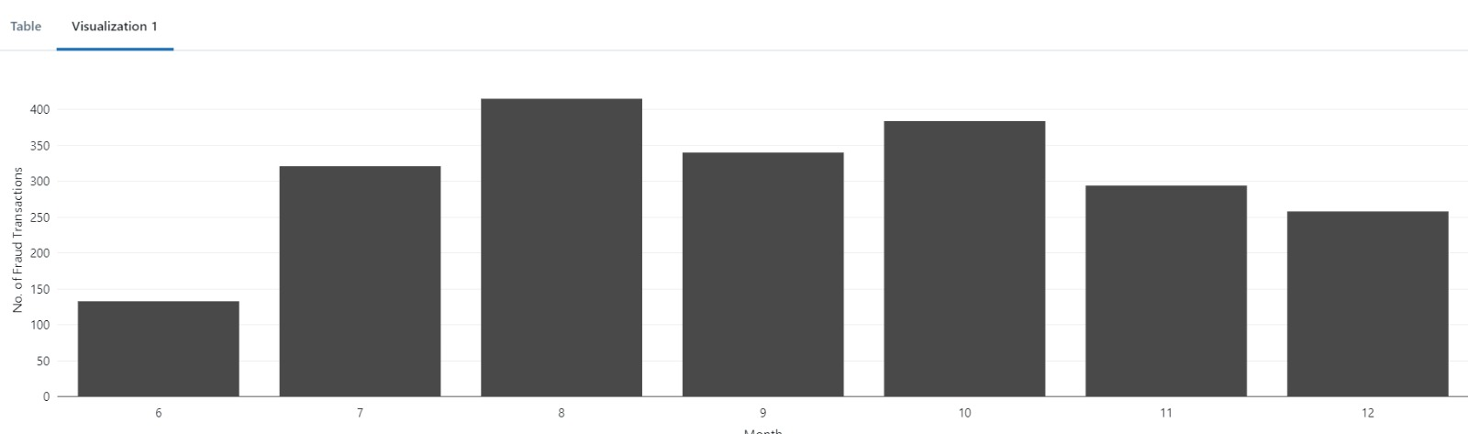
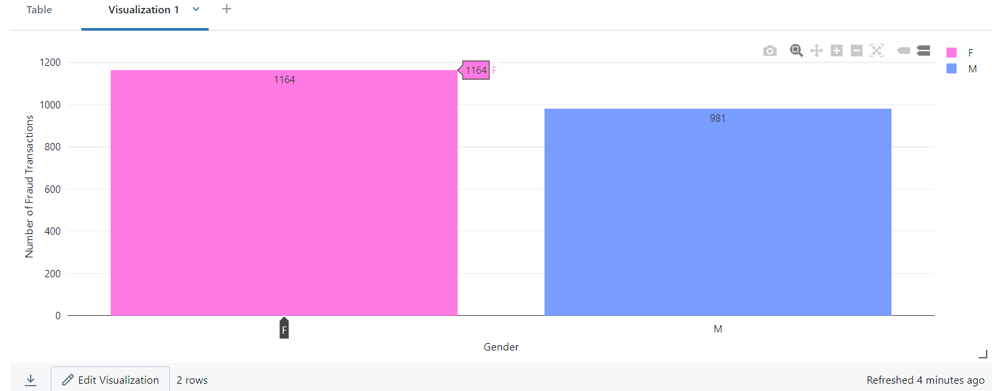
Fraud Transactions by Month
Fraud Transactions Vs Gender

Slide 9
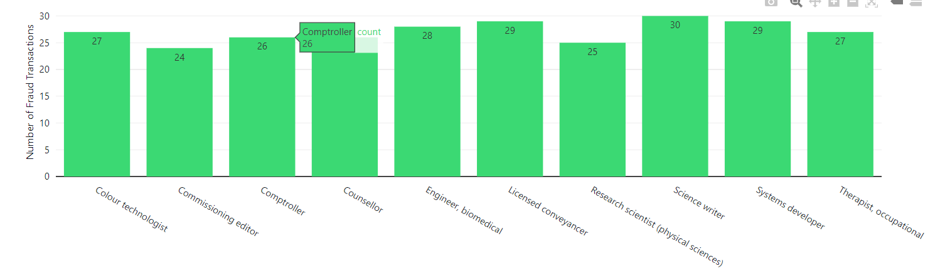
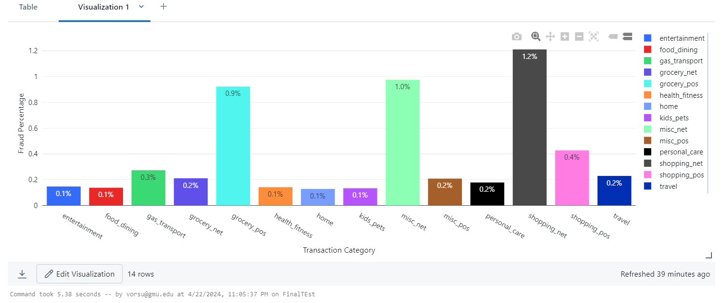
Fraud Transactions by Job Category
Fraud Transactions by Category

Slide 10
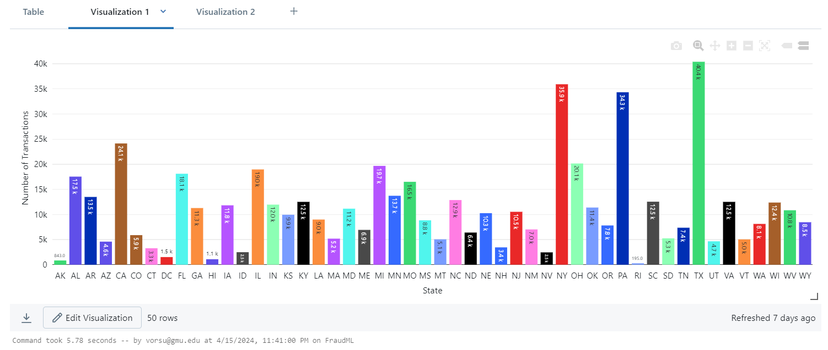
ALL TRANSACTIONS BY STATE

Slide 11
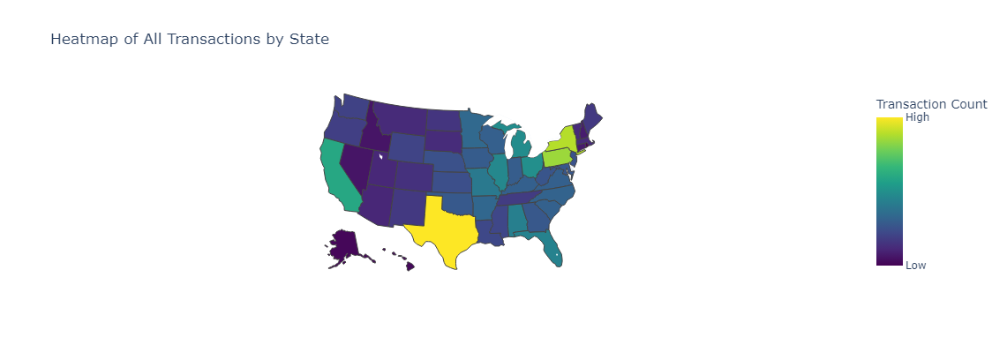
GEOSPATIAL ANALYSIS

Slide 12
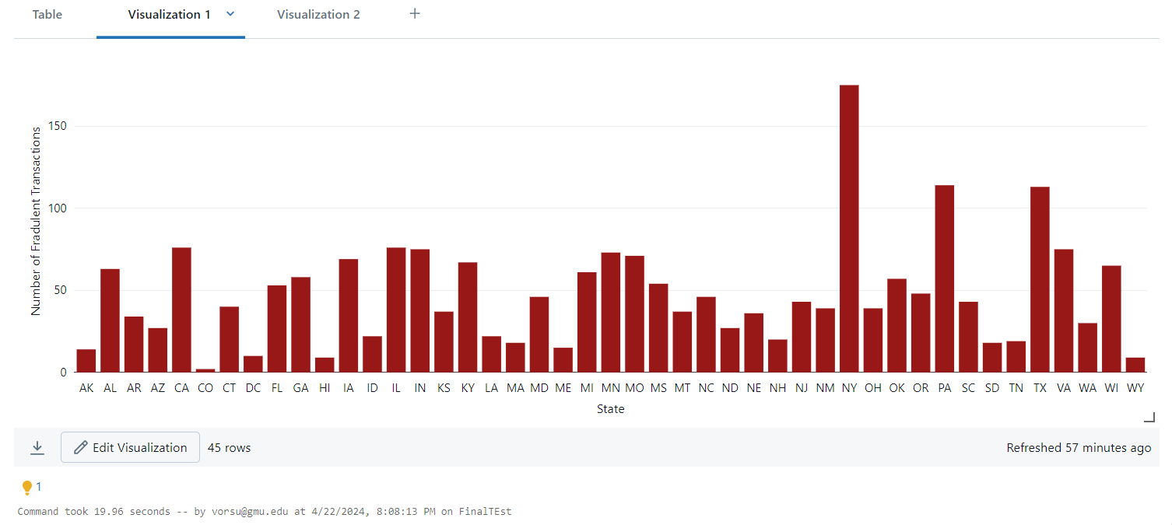
NUMBER OF FRAUD TRANSACTIONS BY STATE

Slide 13
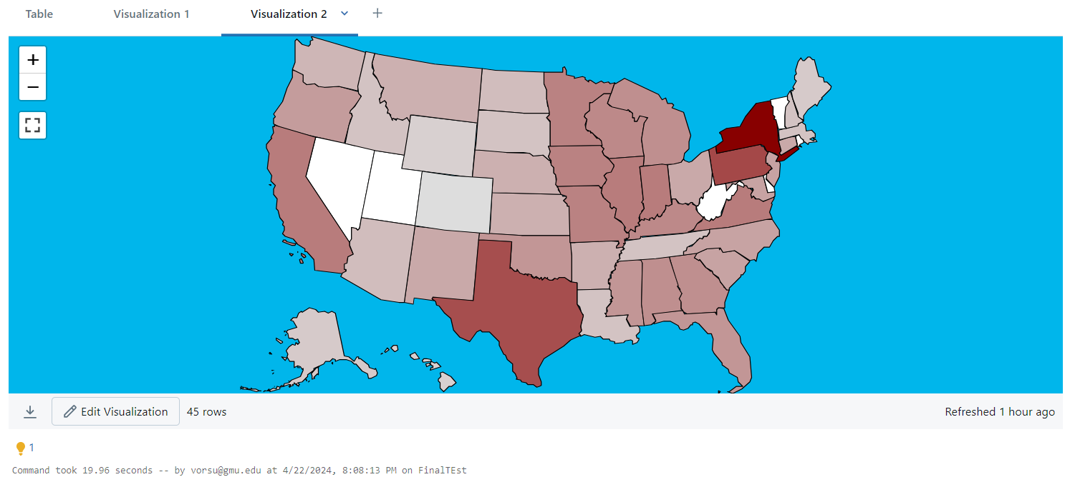
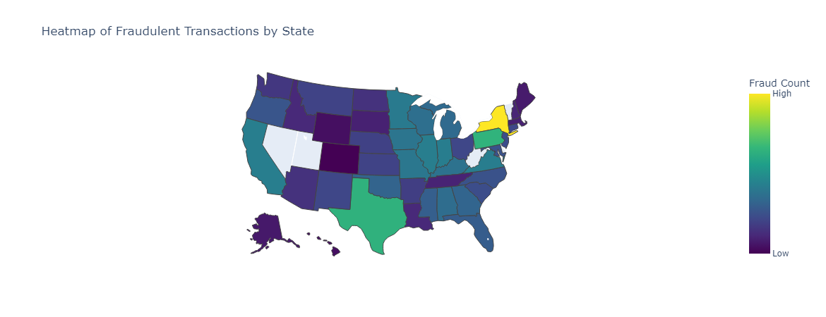
Heatmap of Fraudulent Transactions

Slide 14
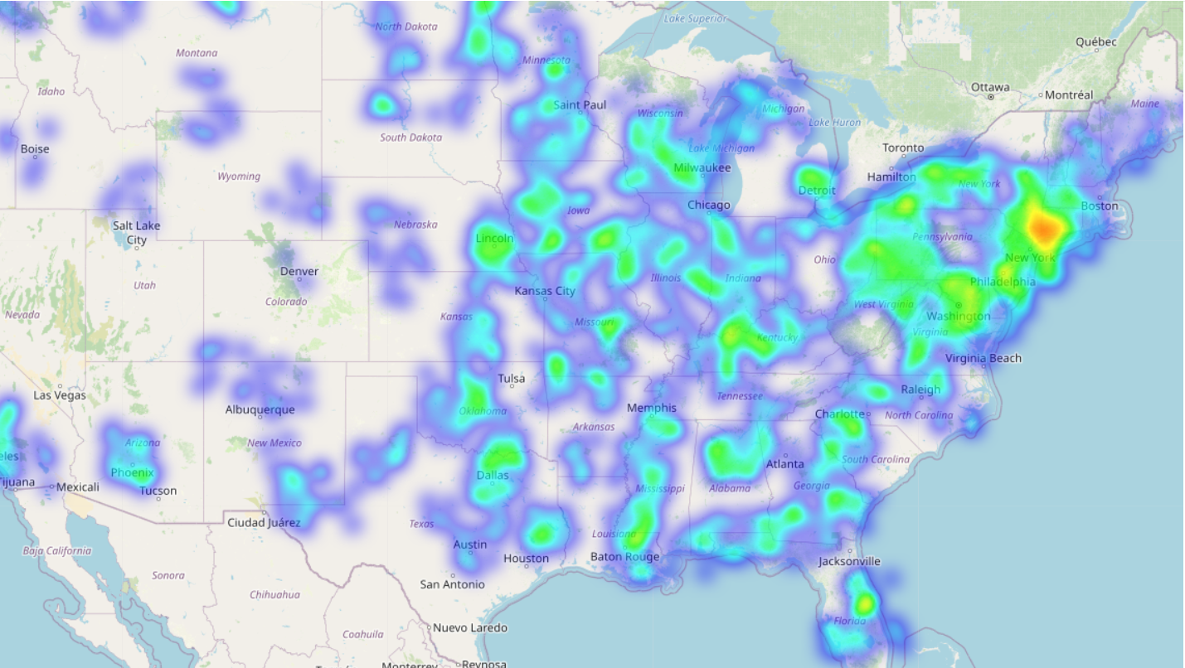
GAZE HEATMAP OF FRAUD TRANSACTIONS

Slide 15
CLASSIFICATION MODEL
LOGISTIC REGRESSION
2. RANDOM FOREST
3. DECISION TREE
4. GRADIENT BOOSTING

Slide 16
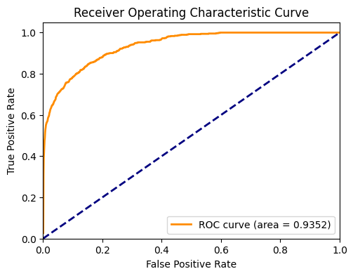
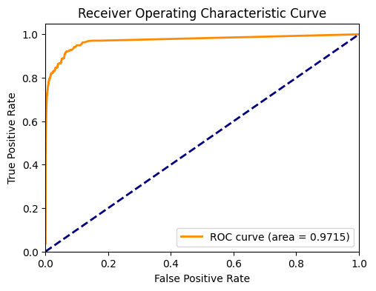
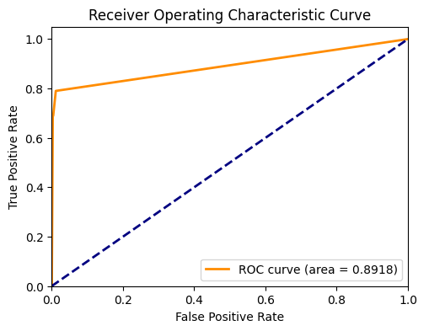
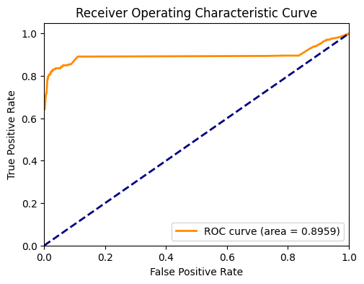
COMPARISON OF AREA UNDER ROC
LOGISTIC REGRESSION
RANDOM FOREST
DECISION TREE
GRADIENT BOOSTING

Slide 17
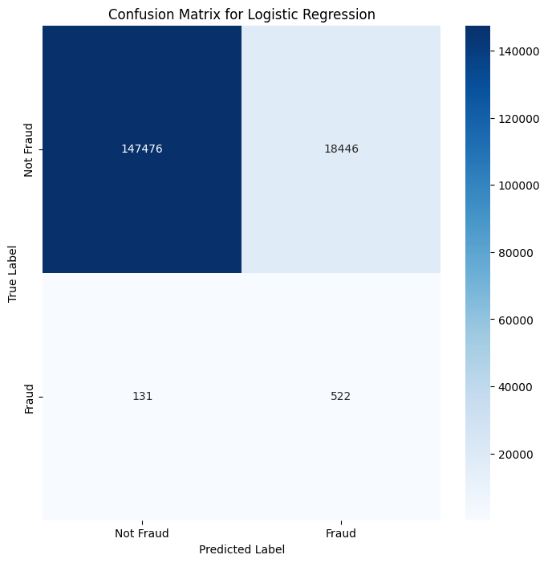
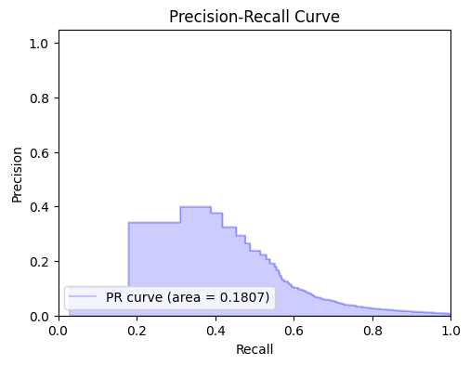
LOGISTIC REGRESSION(PR)

Slide 18
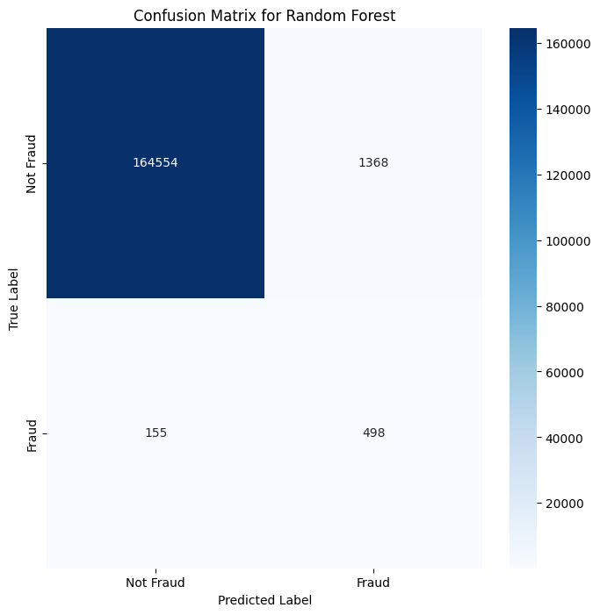
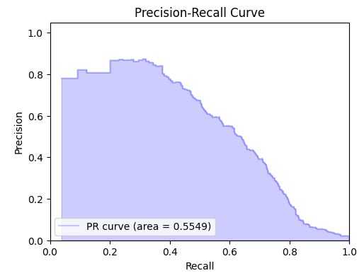
RANDOM FOREST (PR)

Slide 19
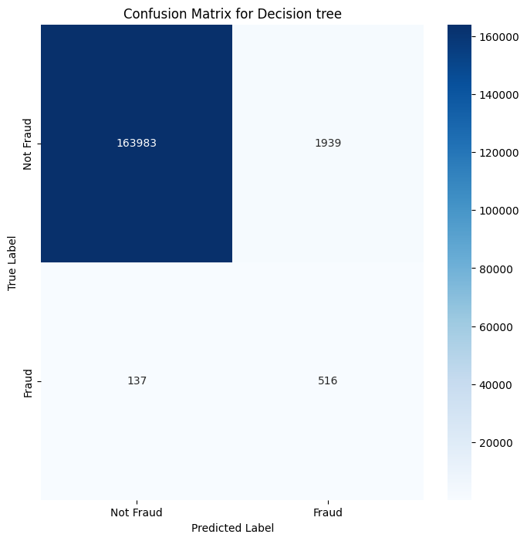
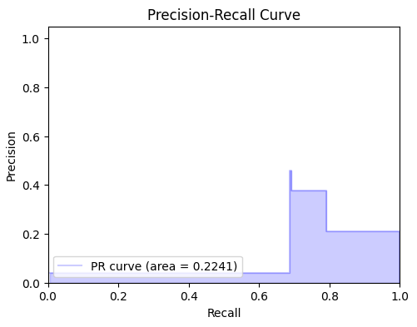
DECISION TREE (PR)

Slide 20

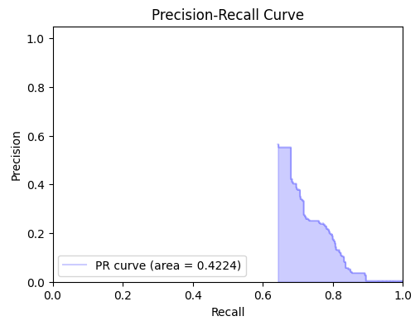
GRADIENT BOOST (PR)

Slide 21
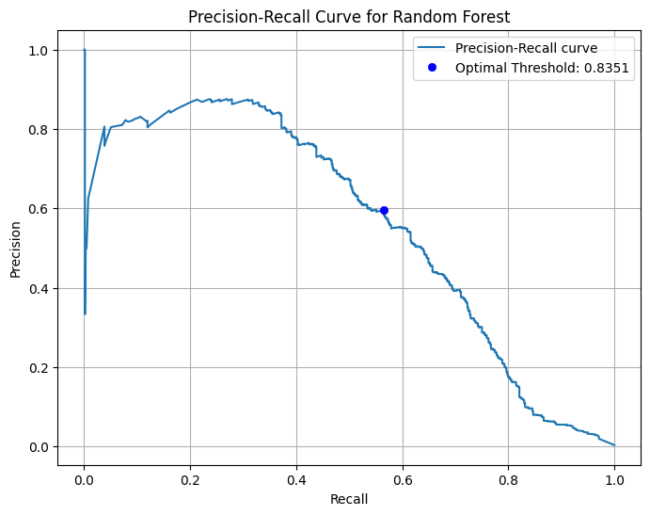
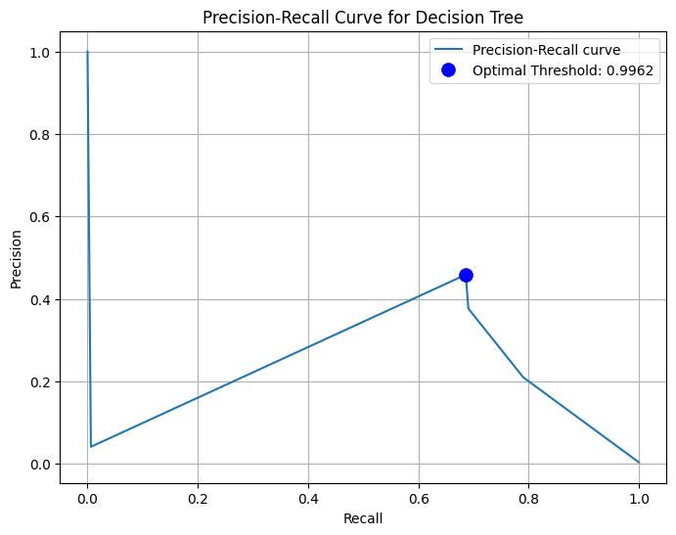
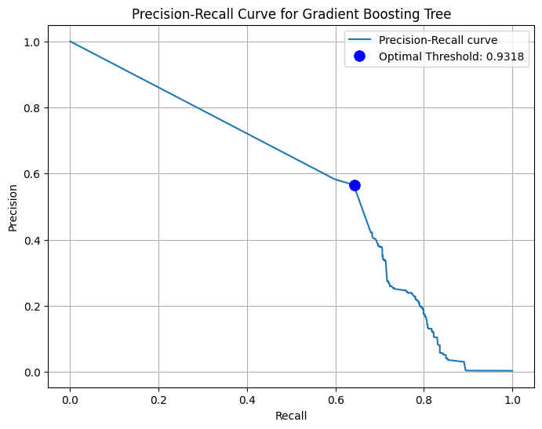
AREA UNDER PRECISION-RECALL

Slide 22
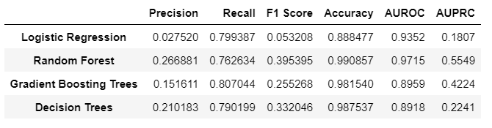
RESULT
Why we got high accuracy:
Class Imbalance: Addressed through balancing techniques like oversampling.
Feature Relevance: Used feature engineering to boost model performance.
Overfitting/Underfitting: Applied regularization and cross-validation to avoid both.
Data Quality: Ensured data is clean and consistent.
Algorithm Limitations: Considered ensemble models for broader coverage.
Model Tuning: Optimized hyperparameters for better results.
External Factors: Adapted to changes in trends and environment.
Way to Improve Low Precision:
Precision-Recall Balance: Adjusting the threshold can help to find a better balance between precision and recall. A higher threshold may decrease recall but increase precision, and vice versa. You can use precision-recall curves to find the optimal threshold for your specific use case.
Trade-off Tuning: By raising the threshold, you can make the model more conservative in predicting fraud; it will only predict fraud when it is more certain. This can reduce the number of false positives (i.e., transactions that are predicted as fraud but are actually legitimate), thereby increasing precision.

Slide 23
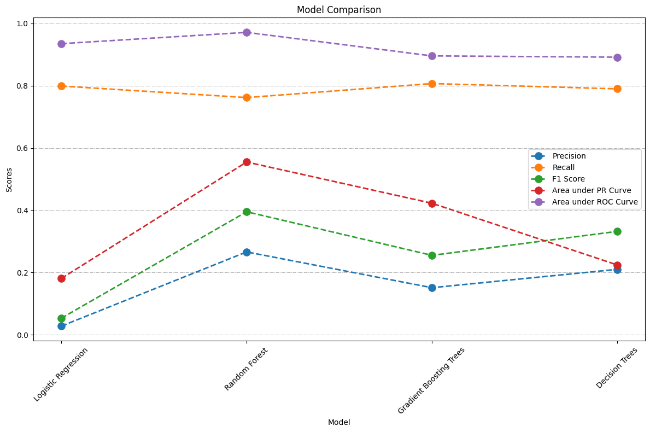
MODEL COMPARISON
Logistic Regression:
High recall and AUROC, but low precision, F1 score, and AUPRC.
Random Forest:
Good balance across metrics, with strong AUROC and accuracy.
Gradient Boosting Trees:
High recall and accuracy, but lower precision and AUROC than Random Forest.
Decision Trees:
Moderate scores across the board, with lower AUROC and AUPRC.
Each model has strengths and trade-offs, highlighting the importance of selecting a model based on key metrics.

Slide 24
CONCLUSIONS
New York, Philadelphia & Texas Occupy top 3 positions where Fraud Transactions happened more in number.
Fraudulent Transactions are recorded more with people working as Science Writer’s.
Fraudulent Transactions are mostly recorded in month of August
Fraudulent Transactions are mostly recorded for online shopping when it comes to merchant category.
The average Fraudulent transaction amount is above 500$.
Females have faced more fraudulent transactions with their cards compared to males.

Slide 25
ACKNOWLEDGEMENT
We express our sincere gratitude to Dr. Liao Duoduo for her invaluable guidance and insightful feedback that significantly shaped our project. Her dedication to academic excellence greatly enhanced our experience. We are also grateful to our teaching assistant, Parth Manish Dalal, for his assistance and support throughout this project. Their combined efforts were crucial to our success.
REFERENCES
[1] A review of credit card fraud detection using Machine Learning techniques | IEEE conference publication | IEEE Xplore. (n.d.). https://ieeexplore.ieee.org/document/9365916
[2] real-time credit card fraud detection using streaming analytics. (n.d.-b). https://www.researchgate.net/publication/316530673_Realtime_credit_card_fraud_detection_using_Streaming_Analytics
DATASET SOURCE
[3] Credit Card Transactions Fraud Detection Dataset. (2020, August 5).
https://www.kaggle.com/datasets/kartik2112/fraud-detection/code

